Slide 1
CAMERAS
Slides are mostly from Svetlana Lazebnik

Slide 2
Overview
Cameras with lenses
Depth of field
Field of view
Lens aberrations
Digital sensors

Slide 3
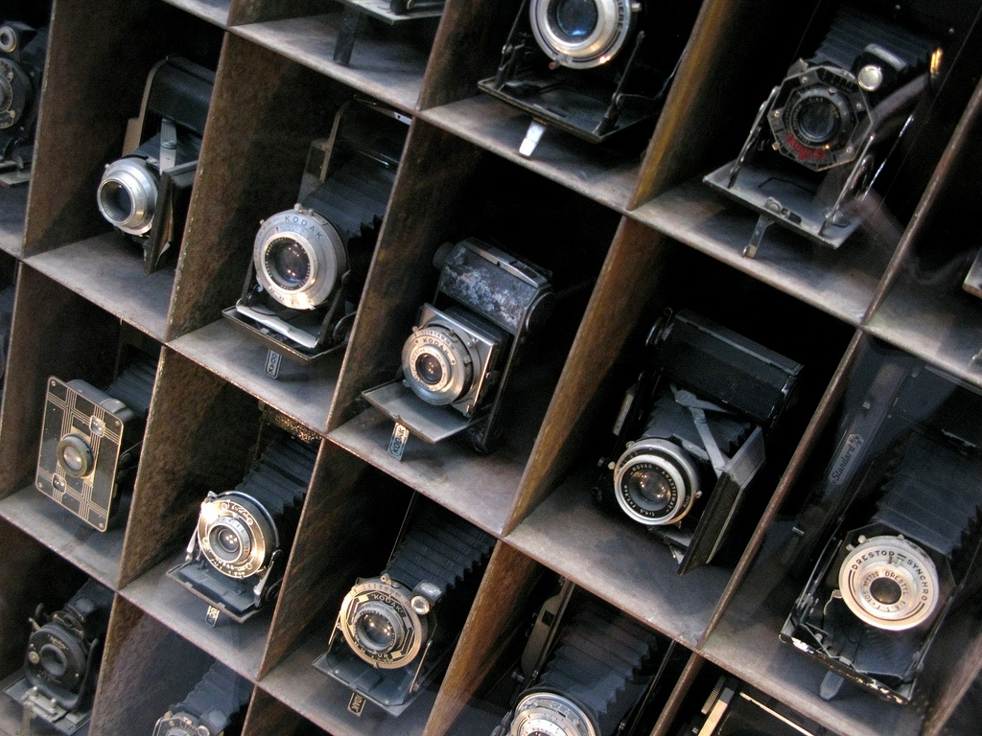
Understanding Real Cameras

Slide 4
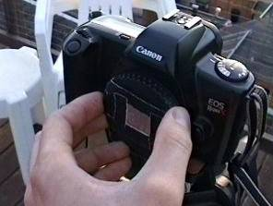
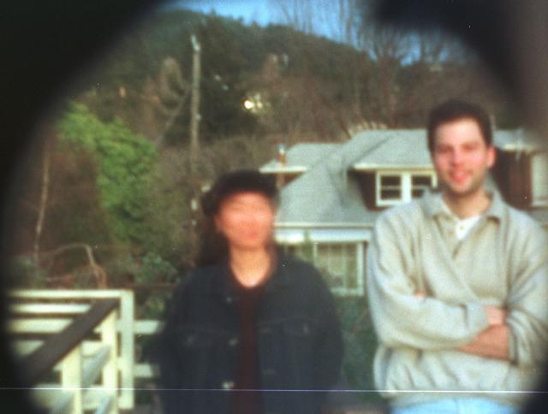
Home-Made Pinhole Camera
Slide by A. Efros
http://www.debevec.org/Pinhole/

Slide 5
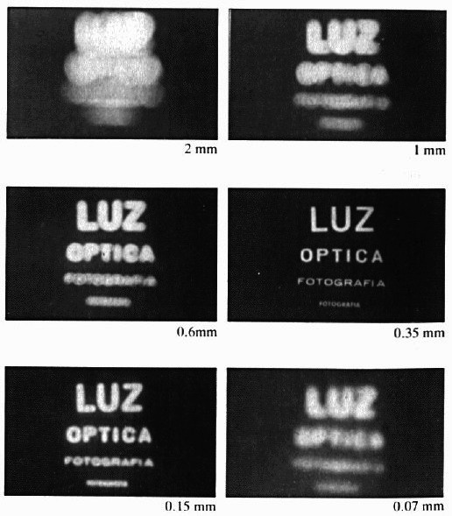
Shrinking the Aperture
Why not make the aperture as small as possible?
Less light gets through
Diffraction effects…
Slide by Steve Seitz

Slide 6
Shrinking the Aperture

Slide 7
Adding a lens

Slide 8
Adding a Lens
A lens focuses light onto the film
Thin lens model:
Rays passing through the center are not deviated (pinhole projection model still holds)
Slide by Steve Seitz

Slide 9
Adding a Lens
focal point
f
A lens focuses light onto the film
Thin lens model:
Rays passing through the center are not deviated (pinhole projection model still holds)
All parallel rays converge to one point on a plane located at the focal length f
Slide by Steve Seitz

Slide 10
Adding a Lens
“circle of
confusion”
A lens focuses light onto the film
There is a specific distance at which objects are “in focus”
other points project to a “circle of confusion” in the image
Slide by Steve Seitz

Slide 11
Thin Lens Formula
What is the relation between the focal length ( f ), the distance of the object from the optical center (D), and the distance at which the object will be in focus (D′)?
D′
D
f
image plane
lens
object
Slide by Frédo Durand
Notes:
This is the relation between the focal length (f), the distance of the object from the camera (D), and the distance at which the object will be in focus (D’)

Slide 12
Thin Lens Formula
Similar triangles everywhere!
D′
D
f
image plane
lens
object
Slide by Frédo Durand

Slide 13
Thin Lens Formula
y′/y = D′/D
Similar triangles everywhere!
D′
D
f
y
y′
image plane
lens
object
Slide by Frédo Durand

Slide 14
Thin Lens Formula
y′/y = D′/D
Similar triangles everywhere!
y′/y = (D′−f )/f
D′
D
f
y
y′
image plane
lens
object
Slide by Frédo Durand

Slide 15
Thin Lens Formula
1
1
1
Any point satisfying the thin lens equation is in focus.
+
=
D′
D
f
D′
D
f
image plane
lens
object
Slide by Frédo Durand
Notes:
And the set of all such points forms a plane parallel to the image (plane of focus).
Uses of the formula: given focal length and depth in scene that you want to be in focus, it tells you where to put the image plane. Given f and distance of image plane from camera center, it tells you which depth in the scene will be in focus.

Slide 16

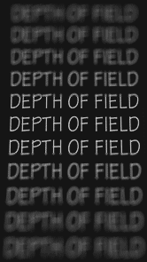
Depth of Field
http://www.cambridgeincolour.com/tutorials/depth-of-field.htm
Slide by A. Efros
Notes:
Depth of field is the distance between the nearest and farthest objects in a scene that appear acceptably sharp in an image (Wikipedia)

Slide 17
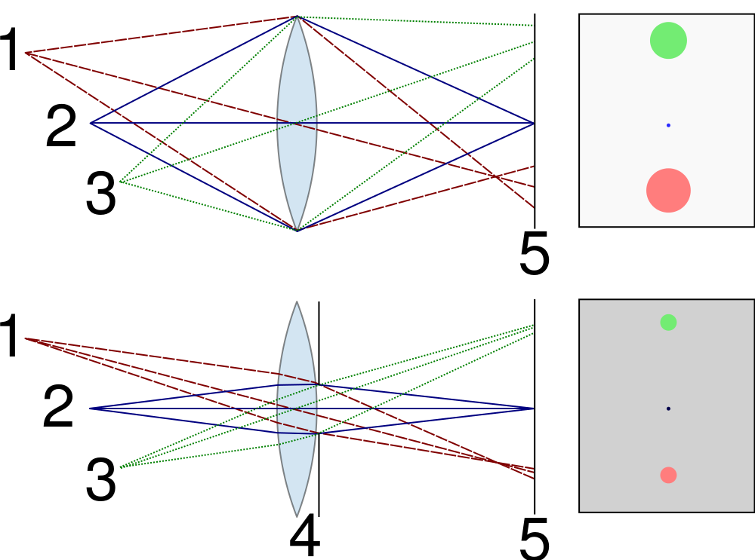


Controlling Depth of Field
Changing the aperture size affects depth of field
A smaller aperture increases the range in which the object is approximately in focus
But small aperture reduces amount of light – need to increase exposure
http://en.wikipedia.org/wiki/File:Depth_of_field_illustration.svg

Slide 18


Varying the Aperture
Large aperture = small DOF
Small aperture = large DOF
Slide by A. Efros

Slide 19
Field of view
The field of view is the angular extent of the world observed by the camera (Wikipedia)
What determines the FOV?
Source: Lazebnik.

Slide 20
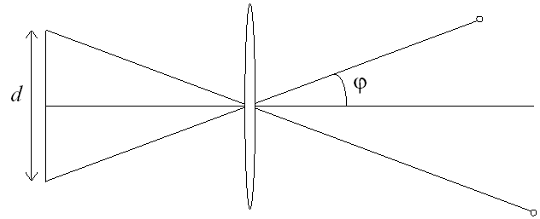
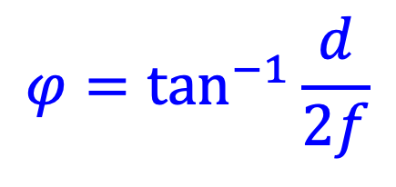
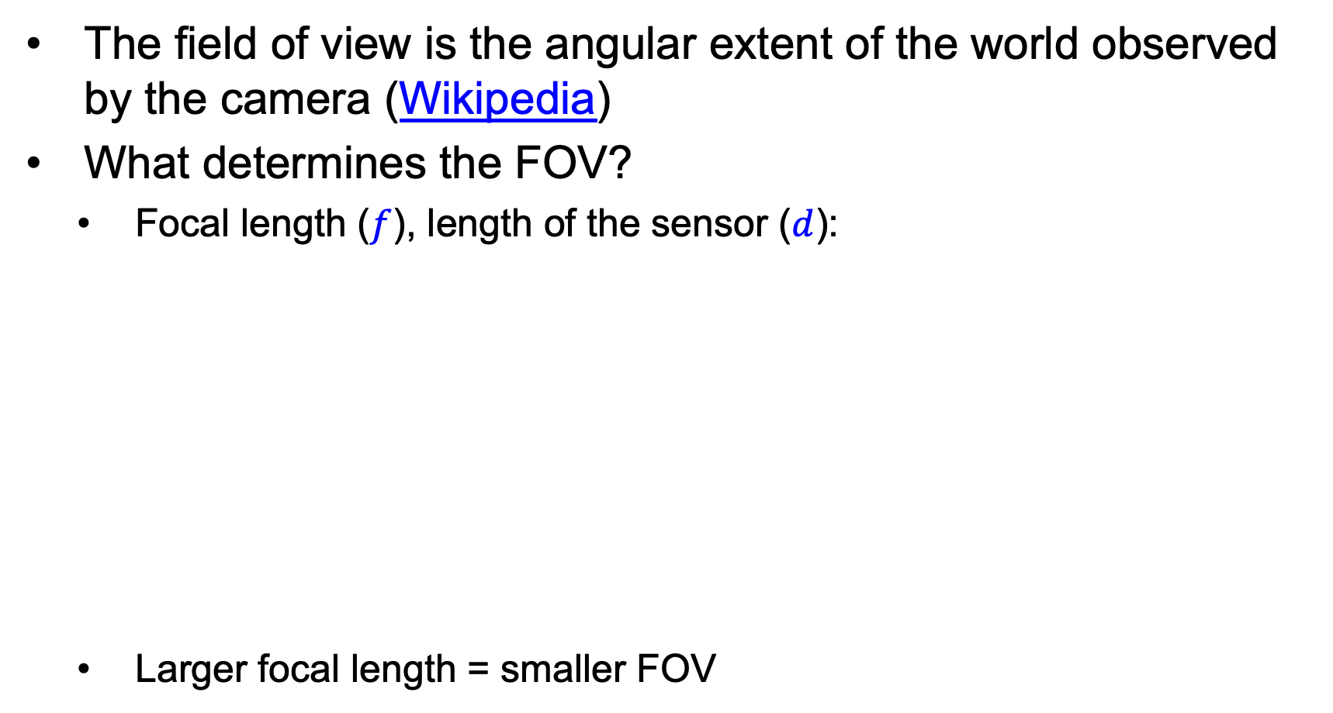
Field of view
The field of view is the angular extent of the world observed by the camera (Wikipedia)
What determines the FOV?
Focal length ($f$), length of the sensor ($d$):
Larger focal length = smaller FOV
f
$$φ=\tan^{−1}{\frac{d}{2f}}$$
Source: Lazebnik.

Slide 21
Field of View
Slide by A. Efros
Notes:
The field of view is the angular extent of the world that is observed by the camera.

Slide 22
Field of View
Slide by A. Efros

Slide 23
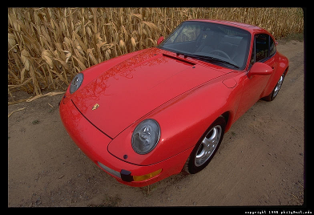
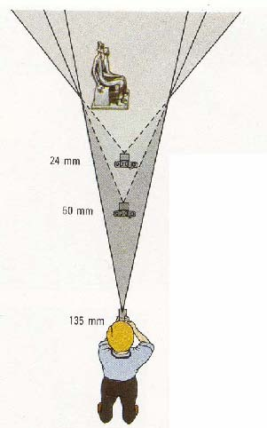
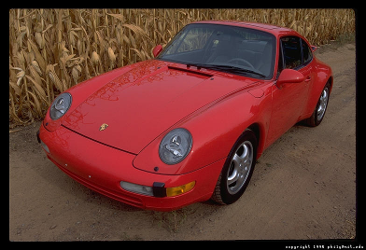
Field of View / Focal Length
Large FOV, small f
Camera close to car
Small FOV, large f
Camera far from the car
Sources: A. Efros, F. Durand

Slide 24



Same Effect for Faces
wide-angle
standard
telephoto
Source: F. Durand

Slide 25
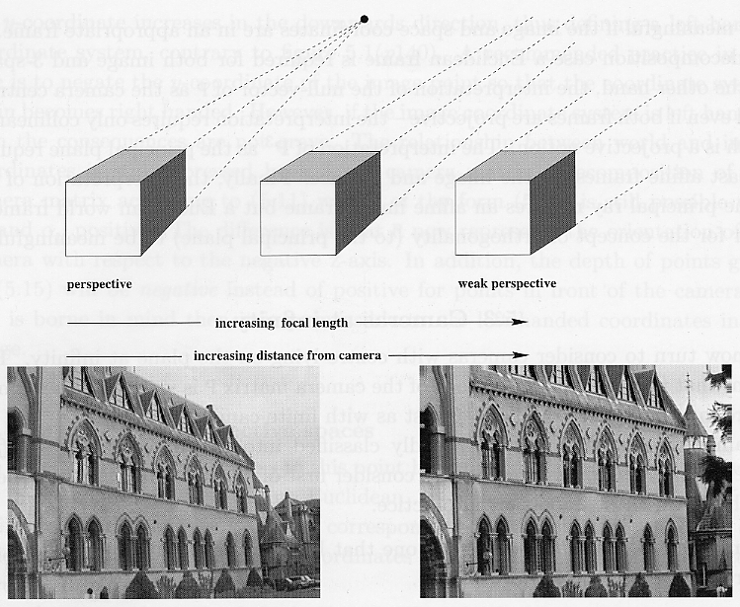
Approximating an Orthographic Camera
Source: Hartley & Zisserman

Slide 26
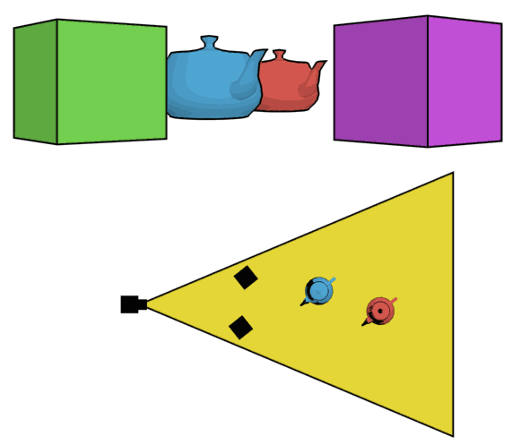
The Dolly Zoom
Continuously adjusting the focal length while the camera moves away from (or towards) the subject
http://en.wikipedia.org/wiki/Dolly_zoom

Slide 27
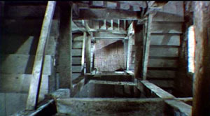
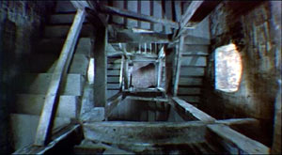
The Dolly Zoom
Continuously adjusting the focal length while the camera moves away from (or towards) the subject
“The Vertigo shot”
Example of dolly zoom from Goodfellas (YouTube)
Example of dolly zoom from La Haine (YouTube)

Slide 28
Choice of Lens and Viewpoint: A COVID-Era Illustration
Source

Slide 29
Overview
Cameras with lenses
Depth of field
Field of view
Lens aberrations

Slide 30
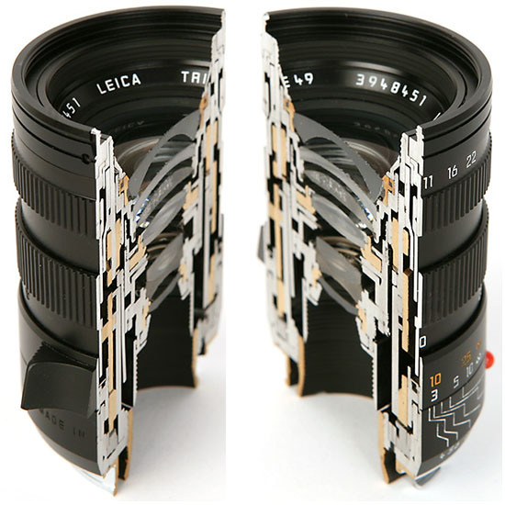
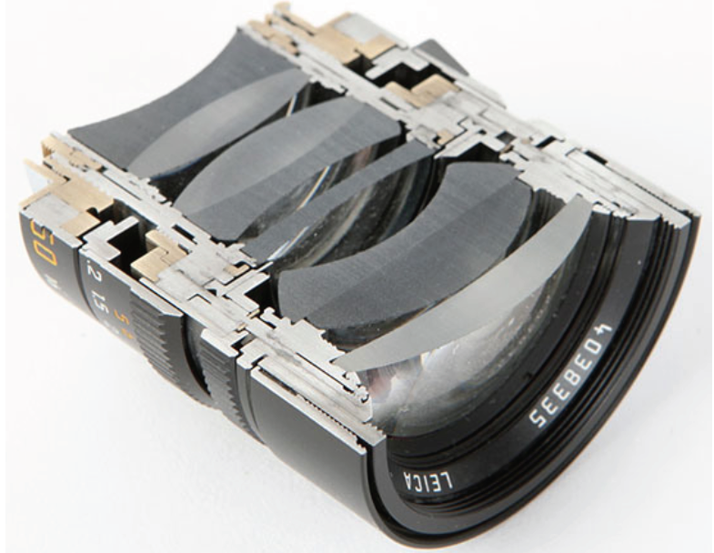
Real Lenses

Slide 31
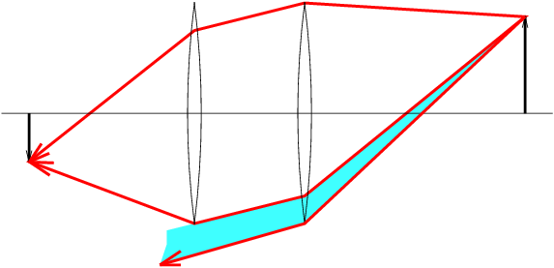
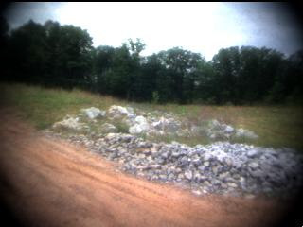
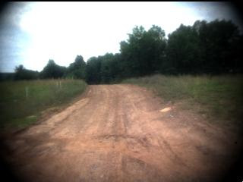
Lens Flaws: Vignetting
Notes:
Vignetting is a term used in photography and optics to describe a reduction in brightness or saturation at the edges of an image compared to the center. This effect is caused by various factors such as the physical design of a lens, improper use of filters or lens hoods, or other environmental factors such as poor lighting conditions.
Vignetting can be characterized by darkening, blurring or distortion at the corners or edges of an image, resulting in a circular or oval shape. This effect can be desirable for artistic or creative purposes, but it can also be undesirable in situations where a clear and evenly lit image is required, such as in technical or scientific photography.

Slide 32
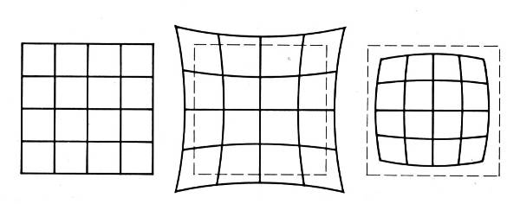
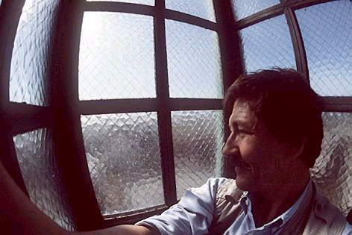
Lens Flaws: Radial Distortion
Caused by imperfect lenses
Deviations are most noticeable near the edge of the lens
No distortion
Pin cushion
Barrel
Notes:
Radial distortion is an optical aberration that causes straight lines to appear curved or bulged inwards or outwards in an image. This distortion occurs when light rays passing through a lens do not converge at a single point on the camera's sensor or film plane. Instead, they converge at slightly different distances from the lens, creating a distorted image.
Radial distortion is usually more pronounced towards the edges of the image and can be caused by various factors, including the lens design, the aperture setting, and the distance between the lens and the object being photographed.
There are two types of radial distortion: barrel distortion and pincushion distortion. Barrel distortion causes straight lines to curve outward, while pincushion distortion causes straight lines to curve inward.
Radial distortion can be corrected through post-processing techniques such as using lens correction software or tools to adjust the image's geometry. Some cameras and lenses also have built-in correction mechanisms to correct for this distortion in real-time during the image capture process.

Slide 33
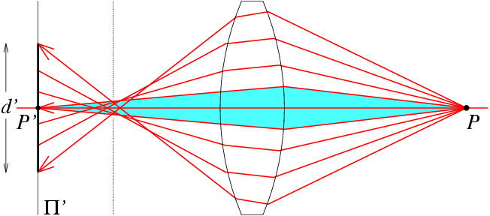
Lens flaws: Spherical Aberration
Spherical lenses don’t focus light perfectly
Rays farther from the optical axis focus closer
Notes:
Radial distortion and spherical aberration are both types of optical aberrations that can affect the quality of an image produced by a lens or optical system, but they differ in their causes and effects.
Radial distortion is caused by the way that light rays pass through a lens and converge on the image sensor or film plane. It causes straight lines to appear curved or bulged inwards or outwards in an image, and it is usually more pronounced towards the edges of the image. Radial distortion can be caused by factors such as the lens design, the aperture setting, and the distance between the lens and the object being photographed.
Spherical aberration, on the other hand, is caused by the way that light rays pass through a lens that is not perfectly shaped or aligned. It causes the edges of an image to be less sharp or focused than the center, resulting in a blurred or hazy appearance. Spherical aberration affects the entire image, rather than just the edges, and it can be caused by factors such as lens shape, lens alignment, and the refractive index of the lens material.
In summary, radial distortion causes curved or bulged lines in an image, while spherical aberration causes a loss of sharpness or focus in the entire image. Both types of aberrations can be corrected through various means such as lens design, specialized coatings, or post-processing techniques.

Slide 34
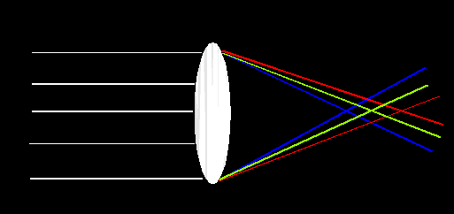
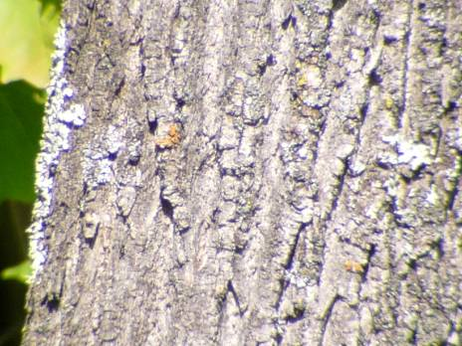
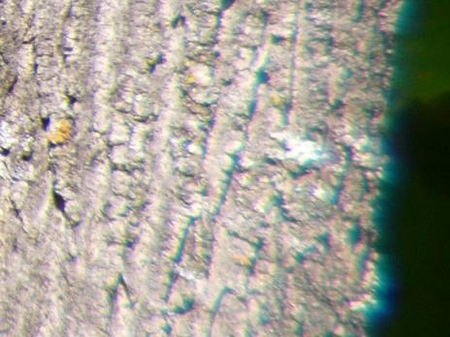
Lens Flaws: Chromatic Aberration
Lens has different refractive indices for different wavelengths: causes color fringing
Near Lens Center
Near Lens Outer Edge
Notes:
Spherical aberration and chromatic aberration are both types of optical aberrations that can affect the quality of an image produced by a lens or optical system.
Spherical aberration occurs when light rays passing through the edges of a lens are refracted differently than those passing through the center, resulting in a blurred or distorted image. This can occur when a lens is not perfectly shaped, resulting in uneven focusing and a loss of image sharpness. Spherical aberration affects all colors of light equally and does not result in color fringing.
Chromatic aberration, on the other hand, occurs when different colors of light are refracted differently by the lens, resulting in color fringing or a rainbow-like effect around edges and high-contrast areas in the image. This effect is caused by the fact that different colors of light have different wavelengths and refract differently when passing through a lens. Chromatic aberration can be reduced by using special lens coatings or materials that are designed to minimize the differential refraction of different colors of light.
In summary, spherical aberration affects the overall sharpness and clarity of an image, while chromatic aberration affects the color accuracy and can result in color fringing. Both types of aberrations can be corrected through various means such as lens design, specialized coatings, or post-processing techniques.

Slide 35
Overview
Cameras with lenses
Depth of field
Field of view
Lens aberrations
Digital sensors

Slide 36
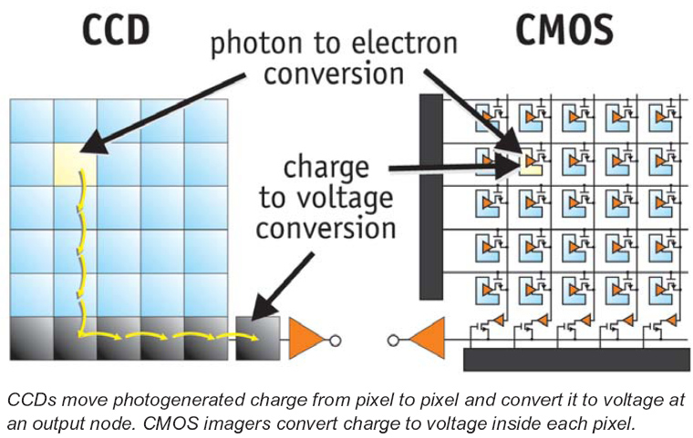
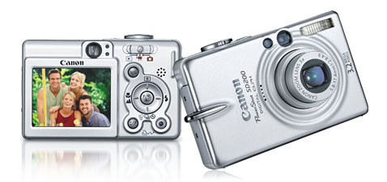
Digital Camera
A digital camera replaces film with a sensor array
Each cell in the array is light-sensitive diode that converts photons to electrons
Two common types
Charge Coupled Device (CCD)
Complementary metal oxide semiconductor (CMOS)
http://electronics.howstuffworks.com/digital-camera.htm
Slide by Steve Seitz

Slide 37
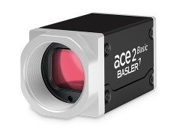
An Industrial Camera Example
Sensor Vendor | Sony
Sensor | IMX547
Shutter | Global Shutter
Sensor Format | 1/1.8''
Sensor Type | CMOS
Sensor Size | 6.7 mm x 5.6 mm
Resolution (HxV) | 2448 px x 2048 px
Resolution | 5 MP
Pixel Size (H x V) | 2.74 µm x 2.74 µm
Frame Rate | 23 fps
Mono/Color | Color
Interface | GigE
Pixel Bit Depth | 8/10/12 bits
Synchronization | free-run hardware trigger software trigger
Exposure Control | programmable via the camera API hardware trigger
Digital Input | 1
General Purpose I/O | 2
Power Supply | PoE or 12-24 VDC
Power Requirements (typical) | 2.9 W
https://www.baslerweb.com/en/products/cameras/area-scan-cameras/ace2/a2a2448-23gcbas/#specs
Notes:
Global shutter and rolling shutter are two different methods used by digital cameras to capture images.
Global shutter, also known as electronic shutter, captures the entire image sensor simultaneously. In a global shutter camera, all the pixels of the sensor are exposed at the same time and the exposure time is synchronized across the entire sensor. The image is then read out and digitized in one operation. Global shutter is commonly used in scientific, industrial, and high-end professional cameras where fast shutter speeds and precise timing are required.
On the other hand, rolling shutter captures the image sensor line by line sequentially. In a rolling shutter camera, the exposure time varies as each line of the image sensor is exposed in sequence. As a result, the image is captured over a period of time, rather than all at once. This can cause distortion in moving objects, especially if they are moving quickly across the frame. Rolling shutter is commonly used in consumer cameras, smartphones, and other portable devices.
The main advantage of global shutter is that it can capture fast-moving objects with minimal distortion, making it ideal for applications such as sports photography or high-speed videography. Rolling shutter, on the other hand, is typically more cost-effective and can be implemented in smaller and more portable devices.
Exposure control is a fundamental aspect of photography and refers to the process of controlling the amount of light that reaches the camera's image sensor. Proper exposure is essential to achieve a well-balanced and visually appealing image.
In a camera, there are three key elements that are used to control exposure: aperture, shutter speed, and ISO.
Aperture is the size of the opening in the lens that allows light to pass through to the image sensor. By adjusting the aperture, you can control how much light reaches the sensor. A larger aperture (smaller f-number) will allow more light to pass through, while a smaller aperture (larger f-number) will allow less light to pass through.
Shutter speed refers to the amount of time that the camera's shutter remains open to allow light to reach the sensor. By adjusting the shutter speed, you can control the duration of exposure. A faster shutter speed will allow less light to reach the sensor, while a slower shutter speed will allow more light to reach the sensor.
ISO refers to the sensitivity of the camera's image sensor to light. By adjusting the ISO, you can control how much the sensor amplifies the light that reaches it. A higher ISO setting will make the sensor more sensitive to light, allowing you to use faster shutter speeds or smaller apertures in low light conditions.
Proper exposure is achieved by balancing these three elements to achieve the desired level of brightness or darkness in the image. In manual mode, the photographer has full control over all three elements and can adjust them to achieve the desired exposure. In automatic modes, the camera's exposure control system uses a combination of these elements to calculate the optimal exposure for the given scene.

Slide 38
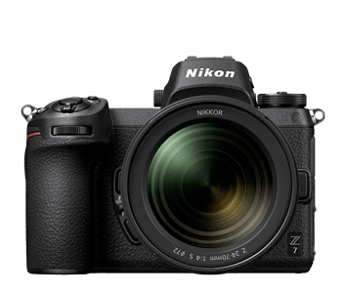
A Professional Photography Camera Example (Z7)
Effective Pixels | 45.7 million
Shutter | Electronically-controlled vertical-travel focal-plane mechanical shutter; electronic front-curtain shutter; electronic shutter
Shutter Speed | 1/8000 to 30 sec. in steps of 1/3 or 1/2 EV, bulb, time, X200
Sensor Format | FX-format
Sensor Type | CMOS
Sensor Size | 35.9 mm x 23.9 mm
Sensor | Sony (IMX309BQJ) ^{Rumor}
ISO Sensitivity | ISO 64 - 25,600 in steps of 1/3 or 1/2 EV
Movie | 4K UHD 3,840 x 2,160 / 30 fps, Full HD 1,920 x 1,080 / 120 fps etc.
Total Pixels | 46.89 million
Resolution (HxV) | 8,256 px x 5,504 px
https://www.nikonusa.com/en/nikon-products/product/mirrorless-cameras/z-7.html#tab-ProductDetail-ProductTabs-TechSpecs
Notes:
FX and DX are two different sensor formats used by Nikon DSLR cameras.
FX (full-frame) is a sensor format that measures 36mm x 24mm, which is the same size as a traditional 35mm film frame. FX cameras are typically used by professional photographers who need the highest possible image quality and low-light performance. The larger sensor size of FX cameras allows for larger individual pixels, which can capture more light and produce less noise in low-light conditions. FX cameras are also capable of producing a shallower depth of field, which can be useful for portrait or landscape photography.
DX, on the other hand, is a smaller sensor format that measures 24mm x 16mm. DX cameras are typically more affordable and geared towards enthusiasts or hobbyists who want a high-quality camera without the expense of a professional-grade FX camera. The smaller sensor size of DX cameras means that individual pixels are smaller, which can result in more noise in low-light conditions. However, DX cameras can use lenses designed for both DX and FX formats, which can provide more flexibility when selecting lenses.
The choice between FX and DX depends on the specific needs of the photographer. FX cameras offer the highest image quality and low-light performance, but come with a higher price tag. DX cameras are typically more affordable and offer a smaller and more lightweight form factor, but may not provide the same level of image quality as FX cameras. Additionally, the choice of sensor format will also affect the effective focal length of the lenses used, with FX cameras producing a wider field of view than DX cameras when using the same lens.
Regenerate response

Slide 39
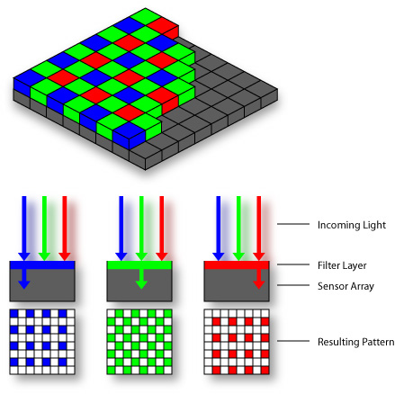

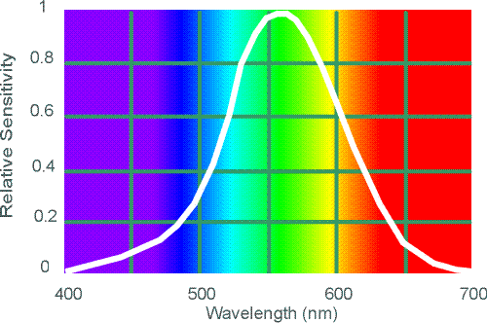
Color filter arrays
Bayer grid (1976)
Demosaicing:
Estimation of missing components from neighboring values
Why more green?
Human Luminance Sensitivity Function
Source: Steve Seitz
Notes:
Demosaicing is the process by which a digital camera converts the raw image data captured by its image sensor into a full-color image. Image sensors in digital cameras use a color filter array (CFA) that is composed of red, green, and blue filters arranged in a repeating pattern. The most common pattern is the Bayer filter array.
When a camera captures an image, each pixel on the sensor only captures one color, either red, green, or blue, depending on which filter is covering it. To produce a full-color image, the camera's image processing software must interpolate the missing colors for each pixel, based on the colors of adjacent pixels that captured different colors.

Slide 40
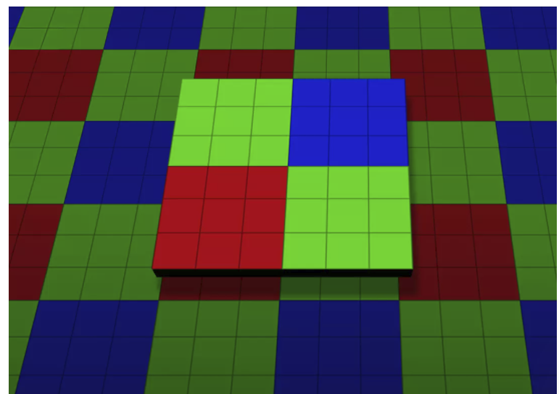
Color filter arrays
Bayer grid (1976)
Demosaicing:
Estimation of missing components from neighboring values
Recent cameraphone technology: pixel binning

Slide 41

Problem with Demosaicing: Color Moire
Slide by F. Durand
Notes:
One problem with demosaicing is the occurrence of color moire.
This happens when there are repetitive or fine details in an image that exceed the resolution of the color filter array. When this happens, the demosaicing process can introduce false colors or patterns in the image, resulting in an unpleasant, shimmering effect that is known as color moire.
Color moire is most commonly seen in fabrics or other patterns that have fine, repetitive details. It can also occur in images of buildings or other structures with repeating patterns, such as brick walls or shingles.
There are a few ways to address color moire in digital images, including using specialized software or tools to remove the moire pattern, or using cameras with advanced sensor designs that incorporate additional filtering or anti-aliasing measures to reduce the occurrence of moire

Slide 42
The Cause of Color Moire
detector
Fine black and white detail in image
misinterpreted as color information
Slide by F. Durand

Slide 43
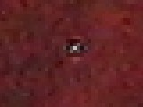

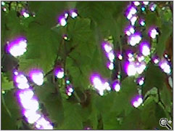
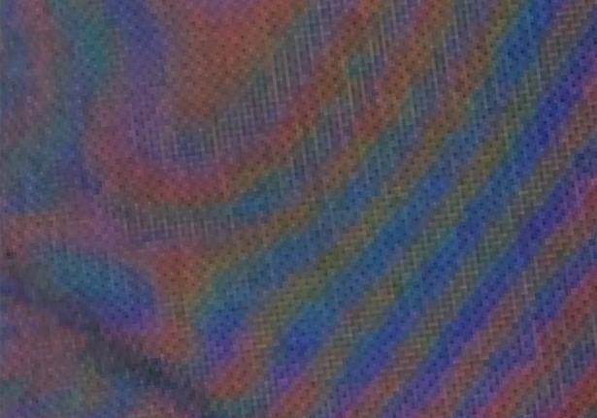
Misc. digital camera artifacts
Noise
low light is where you most notice noise
light sensitivity (ISO) / noise tradeoff
stuck pixels
In-camera processing
oversharpening can produce halos
Compression
JPEG artifacts, blocking
Blooming
CCD charge overflowing into neighboring pixels
Color artifacts
Color moire
Purple fringing from microlenses

Slide 44
Digital Camera Artifacts
Noise
low light is where you most notice noise
light sensitivity (ISO) / noise tradeoff
stuck pixels
In-camera processing
oversharpening can produce halos
Compression
JPEG artifacts, blocking
Blooming
charge overflowing into neighboring pixels
Color artifacts
purple fringing from microlenses,
white balance
Slide by Steve Seitz

Slide 45
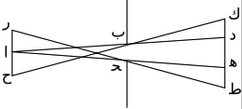
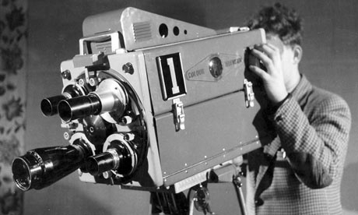
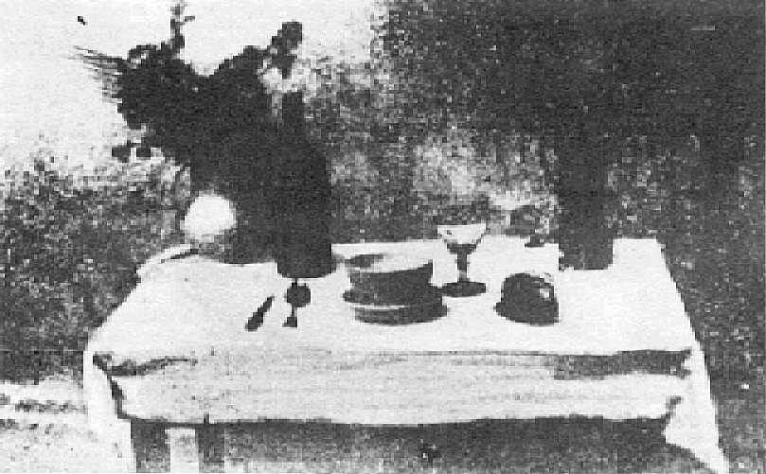
Historic Milestones
Pinhole model: Mozi (470-390 BCE), Aristotle (384-322 BCE)
Principles of optics (including lenses): Alhacen (965-1039 CE)
Camera obscura: Leonardo da Vinci (1452-1519), Johann Zahn (1631-1707)
First photo: Joseph Nicephore Niepce (1822)
Daguerréotypes (1839)
Photographic film (Eastman, 1889)
Cinema (Lumière Brothers, 1895)
Color Photography (Lumière Brothers, 1908)
Television (Baird, Farnsworth, Zworykin, 1920s)
First consumer camera with CCD Sony Mavica (1981)
First fully digital camera: Kodak DCS100 (1990)
Alhacen’s notes
Niepce, “La Table Servie,” 1822
Old television camera

Slide 46
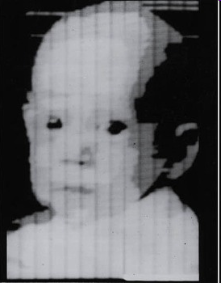
First Digitally Scanned Photograph
1957, 176x176 pixels
http://listverse.com/history/top-10-incredible-early-firsts-in-photography/
Notes:
From the website: “Russell Kirsch was a computer pioneer at the National Institute of Standards and Technology in the USA when he developed the system by which a camera could be fed into a computer. The photo is of Kirsch’s three month old son Walden and it measured a mere 176×176 pixels. Baby Walden now works in communications for Intel.”

Slide 47
Camera Sales Over Time
Source
Notes:
CIPA: Camera & Imaging Products Association

Slide 48
Camera Sales Over Time
The full chart…
More information on color and cameras:
https://www.eecs.yorku.ca/~mbrown/ICCV19_Tutorial_MSBrown.pdf
Source
Notes:
CIPA: Camera & Imaging Products Association

